Slide 1
User Defined Functions, Lambda Expressions and Command Line Arguments

Slide 2
Define functions, pass arguments, and return values, fostering good coding practices and code reuse
Differentiate between different types of function parameters.
Implement Lambda Expression
Use command line arguments

Slide 3
Functions in Python
Introduction
In Python, you can define your own functions using the def keyword.
User-defined functions are a way to encapsulate a block of code that can be executed multiple times with different inputs or arguments.
Here's the basic syntax of defining and using a user-defined function:
def function_name(parameters):
# Function code or statements
return result # Optional
Here's an explanation of the components:
def: The keyword used to define a function.
function_name: The name of the function, which should follow Python naming conventions (letters, underscores, and digits but cannot start with a digit).
parameters: The input values (arguments) that the function can accept. These are optional, and you can have zero or more parameters.
return: An optional keyword used to specify the value or values that the function should return. If omitted, the function returns None.

Slide 4
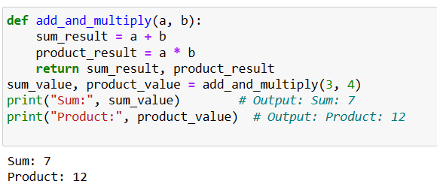
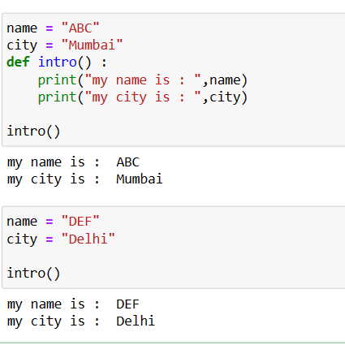
Functions in Python
Defining and Invoking functions
After defining function, we need to call the function.
Function_name(actual value parameters)
Example :
Defining function :
def square(number):
result = number ** 2
return result
Call function :
result = square(5)
print(result) # Output: 25
Global Variable :

Slide 5
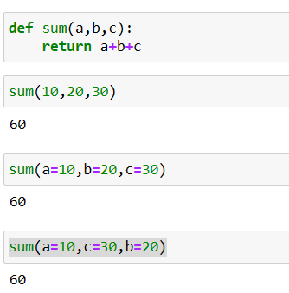
Functions in Python
def greet(name, message="Hello"):
print(f"{message}, {name}!")
# Calling the function with keyword arguments
greet(message="Hi", name="Alice")
# Output: Hi, Alice!
Keyword Arguments
In Python, keyword arguments allow you to pass arguments to a function by explicitly specifying the parameter names along with their values.
This gives you more flexibility and readability when calling functions, especially for functions with a large number of parameters or when you want to provide arguments out of order.
def my_function(param1, param2):
# Function code here
# Calling the function with keyword arguments
my_function(param1=value1, param2=value2)

Slide 6
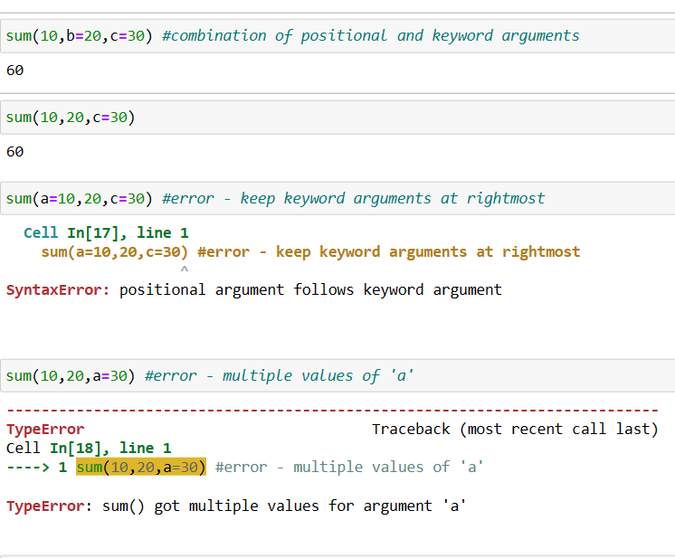
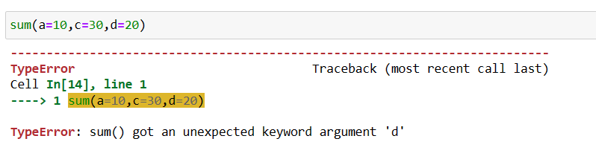
Functions in Python
Keyword Arguments

Slide 7
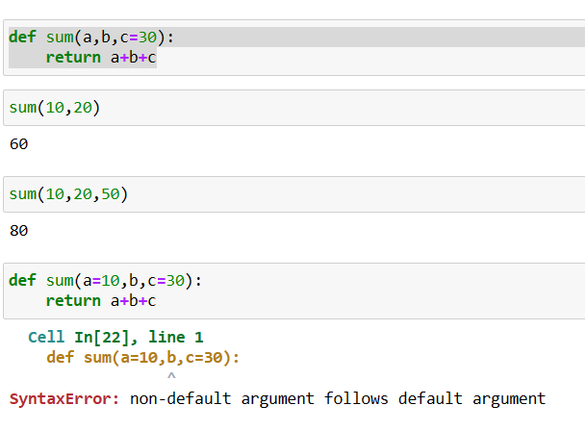
Functions in Python
Default Arguments
In Python, you can define default arguments for function parameters.
Default arguments are values assigned to parameters when the function is defined.
If a caller doesn't provide a value for a parameter, the default value is used instead.
This allows you to create functions with optional arguments while providing sensible defaults.
def function_name(param1=default_value1, param2=default_value2, ...):
# Function code

Slide 8
Functions in Python
2. **kwargs (Arbitrary Keyword Arguments):
allows you to collect a variable number of keyword
arguments into a dictionary.
Variable Length Arguments
In Python, you can define functions that accept a variable number of arguments using the *args and **kwargs syntax.
This allows you to create more flexible functions that can accept any number of positional and keyword arguments.
1. *args (Arbitrary Positional Arguments): allows you to collect a variable number of positional arguments into a tuple.
def print_info(**kwargs):
for key, value in kwargs.items():
print(key, ":", value)
print_info(name="Alice", age=30, city="New York")
# Output:
# name : Alice
# age : 30
# city : New York
def my_function(*args):
for arg in args:
print(arg)
my_function(1, 2, 3, "hello")
# Output:
# 1
# 2
# 3
# hello

Slide 9
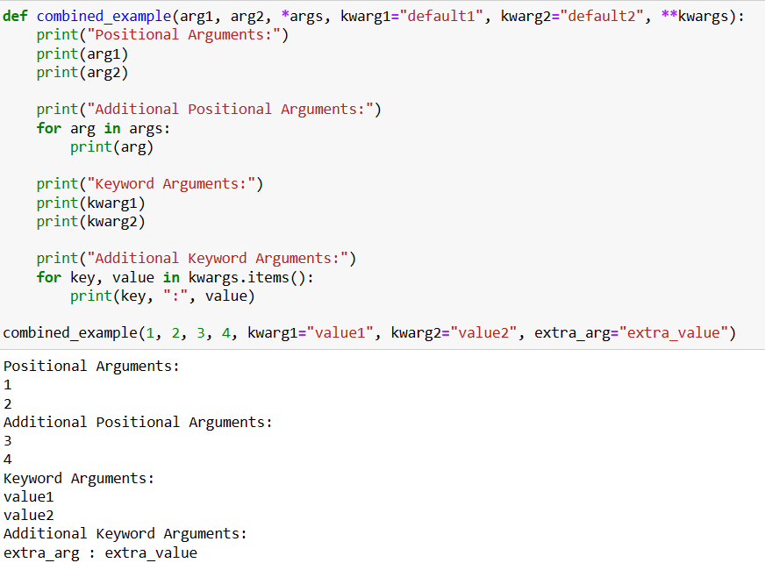
Functions in Python
Combining *args and **kwargs

Slide 10
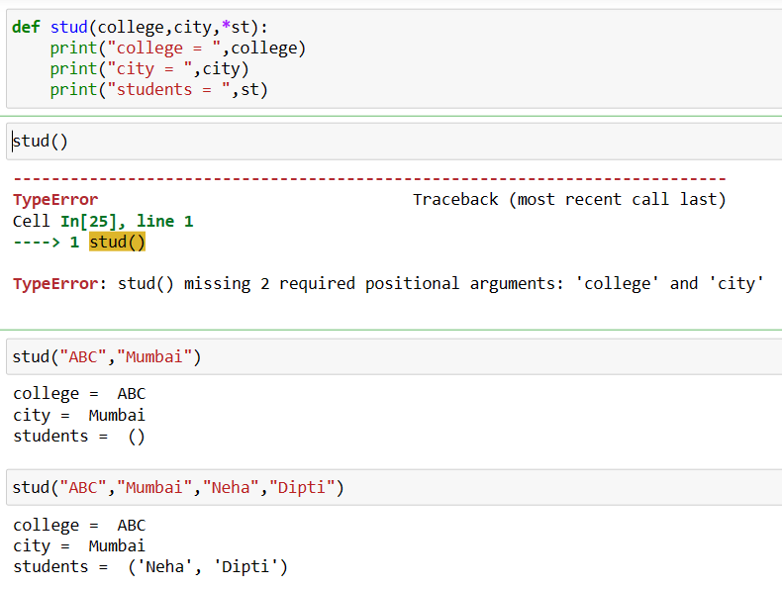
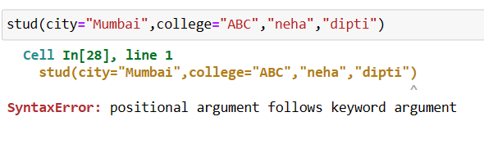
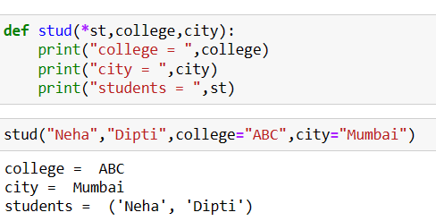
Functions in Python
Solution :

Slide 11
Functions in Python
4. Variable-Length Arguments (*args and **kwargs):
Variable-length arguments allow a function to accept a variable number of arguments, either positional or keyword, making the function more flexible.
*args allows you to collect a variable number of positional arguments into a tuple.
**kwargs allows you to collect a variable number of keyword arguments into a dictionary.
They are useful when you want to create functions that can handle different numbers of inputs.
1. Positional Arguments:
Positional arguments are the most common type of arguments in Python.
They are passed to a function in the same order as the function's parameter list.
Positional arguments are matched with parameters based on their position, so the first argument corresponds to the first parameter, the second argument corresponds to the second parameter, and so on.
2. Keyword Arguments:
Keyword arguments are passed to a function with their parameter names explicitly mentioned.
They allow you to specify which argument corresponds to which parameter, regardless of the order.
Keyword arguments are particularly useful when you have functions with many parameters, and you want to make your code more readable.
3. Default Arguments:
Default arguments have default values assigned to them when defining a function.
If a caller does not provide a value for a default argument, the default value is used.
They allow you to make certain arguments optional, as they provide a fallback value when not explicitly provided.

Slide 12
Anonymous/Lambda functions
Anonymous function are not declared using def keyword and do not have a function name.
Lambda keyword is used to create Anonymous function .
Lambda function can take any number of parameter .
Lambda function return an expression .
Lambda function cannot be called directly .
To call lambda we need an expression .
lambda [arg1 [,arg2,.....argn]]:expression

Slide 13
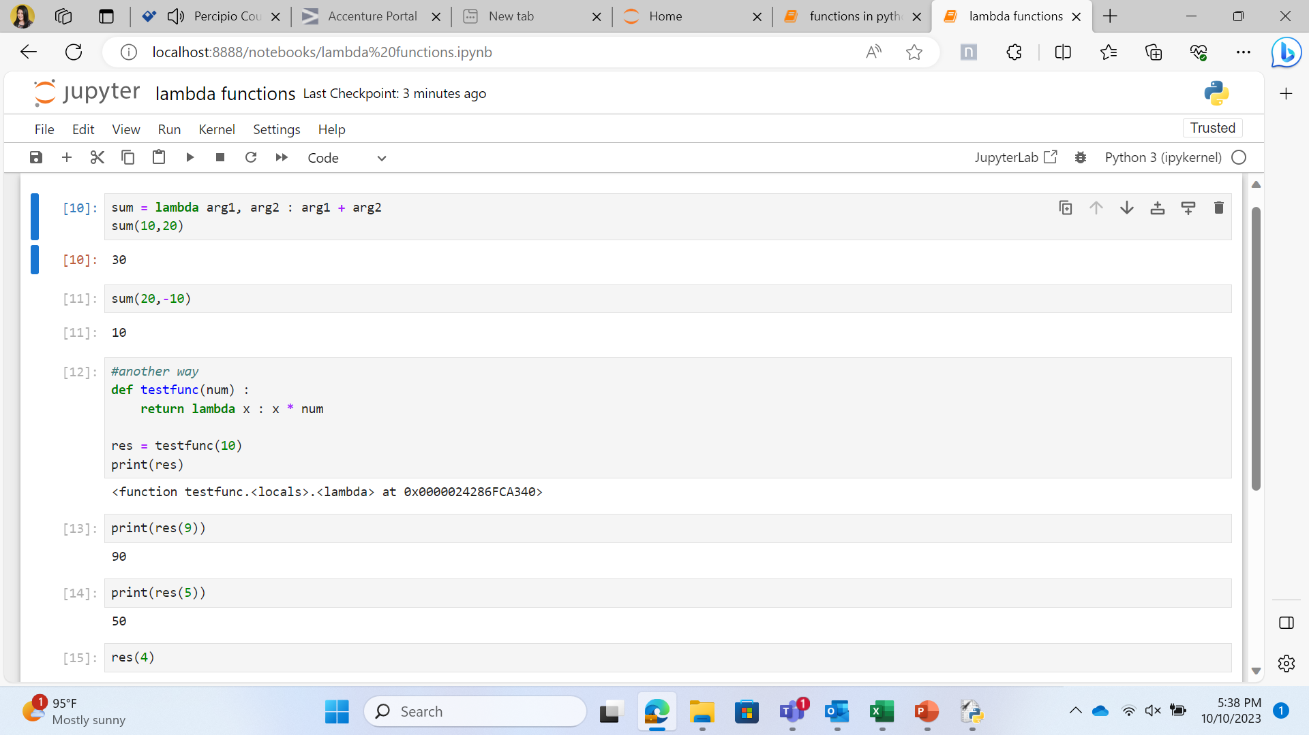
Demo : Lambda Function

Slide 14
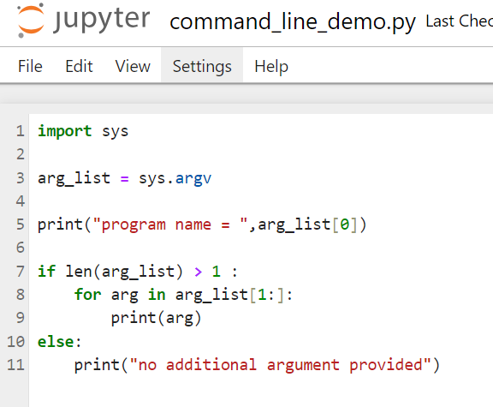
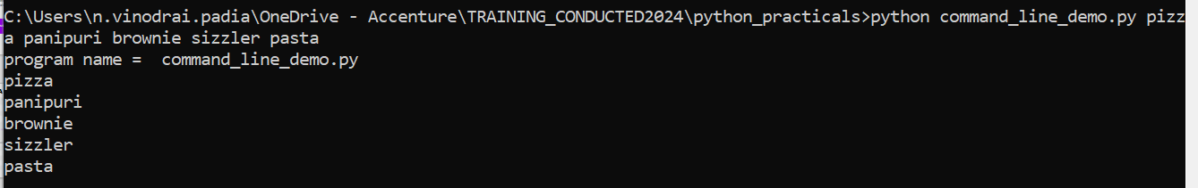
Command line arguments
Note : By default, data type of command line arguments
Is String (Refer e.g. Fibonnacci.py)

Slide 15
Modules in Python
Python file containing Python definitions and statements are called as Module .
Python file name is module name .
We can refer to module name with the help of a global variable __name__
Modules in Python are used to provide modular approach to a Python script
'__main__' is the name of the scope in which top-level code executes
If you run a python file directly __name__ has __main__ value .
if __name__==‘__main__’:
Statements

Slide 16
Python Execution Model
Python execution model consists of Module, Script and Programs
• Module
It can be any .py file that consists of module.
It can written for convenient imports
• Script
.py file should have if __name__ = __main__
• Program
It is composed of modules

Slide 17
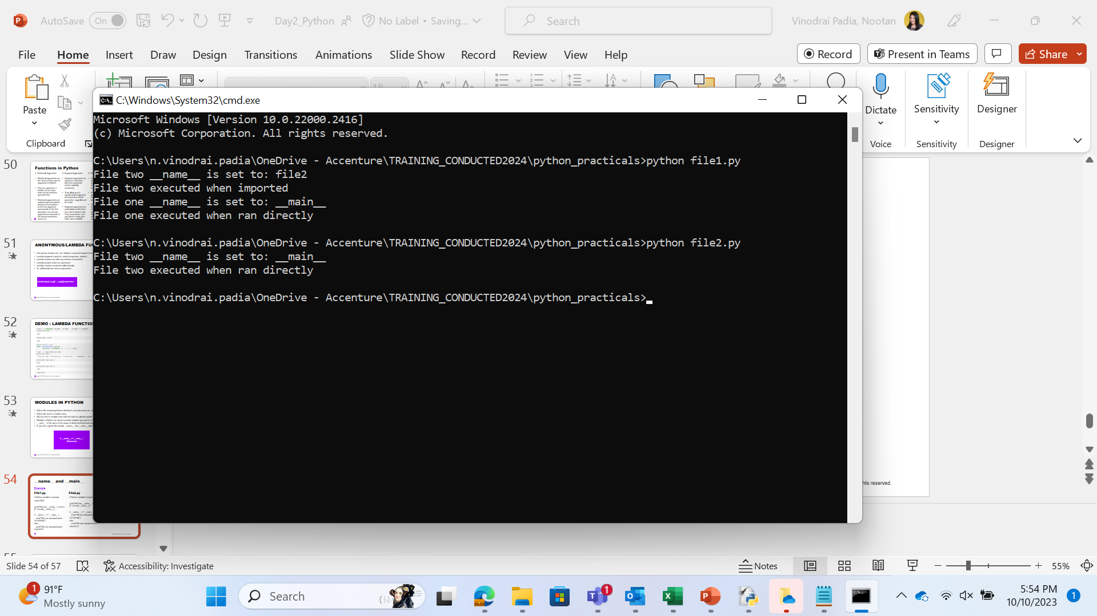
__name__ and __main__
File2.py
Example
File1.py
# Python module to import
print("File two __name__ is set to: {}" .format(__name__))
if __name__ == "__main__":
print("File two executed when ran directly")
else:
print("File two executed when imported")
# Python module to execute
import file2
print("File one __name__ is set to: {}" .format(__name__))
if __name__ == "__main__":
print("File one executed when ran directly")
else:
print("File one executed when imported")

Slide 18
Knowledge Check (1 of 10)
What is the default return value of a function that does not have a return statement?
a) 0
b) None
c) Empty String
d) Error
Notes:
Key Message/s: Answer: Option B

Slide 19
Knowledge Check (2 of 10)
What will be the output of the following function call?
def test(x, lst=[]):
lst.append(x)
return lst
print(test(1))
print(test(2, []))
print(test(3))
a) [1] [2] [3]
b) [1] [2] [1, 3]
c) [1] [2] [3, 1]
d) [1] [2] [1, 2, 3]
Notes:
Key Message/s: Answer: Option B

Slide 20
Knowledge Check (3 of 10)
What will be the output of the following code?
def greet():
return "Hello, World!"
print(greet())
A) Hello, World!
B) None
C) Error
D) greet()
Notes:
Key Message/s: Answer: Option A: Hello, World!

Slide 21
Knowledge Check (4 of 10)
What keyword is used to define a function in ?
A) function
B) define
C) def
D) func
Notes:
Key Message/s: Answer: Option C: def

Slide 22
Knowledge Check (5 of 10)
What will be the output of the following code?
def add(a, b):
return a + b
print(add(2, 3))
A) 5
B) 2 + 3
C) Error
D) None
Notes:
Key Message/s: Answer: Option A: 5

Slide 23
Knowledge Check (6 of 10)
What will be the output of the following code?
def my_func():
pass
print(my_func())
A) None
B) Error
C) pass
D) my_func()
Notes:
Key Message/s: Answer: Option A: None

Slide 24
Knowledge Check (7 of 10)
What will be the output of the following function call?
def multiply(x, y=2):
return x * y
print(multiply(3))
A) 3
B) 6
C) None
D) Error
Notes:
Key Message/s: Answer: Option B: 6

Slide 25
Knowledge Check (8 of 10)
What will be the output of the following code involving variable scope?
x = 10
def func():
x = 5
print(x)
func()
print(x)
A) 5 followed by 5
B) 10 followed by 10
C) 5 followed by 10
D) Error
Notes:
Key Message/s: Answer: Option C: 5 followed by 10

Slide 26
Knowledge Check (9 of 10)
What will be the output of the following function with *args?
def my_sum(*args):
return sum(args)
print(my_sum(1, 2, 3, 4))
A) 10
B) (1, 2, 3, 4)
C) Error
D) None
Notes:
Key Message/s: Answer: Option A: 10

Slide 27
Knowledge Check (10 of 10)
What will be the output of the following function?
What will be the output of the following lambda function?
def double(x):
return x*2
print(double(4))
A) 8
B) 4
C) Error
D) None
Notes:
Key Message/s: Answer: Option A: 10

Slide 28
Knowledge Check (1 of 10)
Which of the following is a valid lambda function?
a) lambda x: x + 1
b) lambda (x, y): x + y
c) def lambda x: x + 1
d) lambda x, y return x + y
Notes:
Key Message/s: Answer: Option A

Slide 29
Knowledge Check (2 of 10)
What will be the output of the following lambda function?
f = lambda x: (x % 2 and "Odd") or "Even"
print(f(3), f(4))
a) Odd Odd
b) Odd Even
c) Even Odd
d) Even Even
Notes:
Key Message/s: Answer: Option B

Slide 30
Knowledge Check (3 of 10)
What is a lambda function in Python?
A) A function that has no name
B) A function that can take only one argument
C) A function that returns None
D) A function that can only be used inside classes
Notes:
Key Message/s: Answer: Option A: A function that has no name

Slide 31
Knowledge Check (4 of 10)
What will be the output of the following lambda function?
add = lambda x, y: x + y
print(add(3, 4))
A) 34
B) 7
C) Error
D) None
Notes:
Key Message/s: Answer: Option B: 7

Slide 32
Knowledge Check (5 of 10)
What will be the output of the following code?
square = lambda x: x * x
print(square(5))
A) 25
B) 5
C) Error
D) None
Notes:
Key Message/s: Answer: Option A: 25

Slide 33
Knowledge Check (6 of 10)
How many arguments can a lambda function take?
A) Only one
B) Only two
C) Any number of arguments
D) None
Notes:
Key Message/s: Answer: Option C: Any number of arguments

Slide 34
Knowledge Check (7 of 10)
What will be the output of the following lambda function used with map()?
nums = [1, 2, 3, 4]
result = list(map(lambda x: x * 2, nums))
print(result)
A) [1, 2, 3, 4]
B) [2, 4, 6, 8]
C) [1, 4, 9, 16]
D) Error
Notes:
Key Message/s: Answer: Option B: [2, 4, 6, 8]

Slide 35
Knowledge Check (8 of 10)
What will be the output of the following lambda function used with filter()?
nums = [1, 2, 3, 4, 5, 6]
result = list(filter(lambda x: x % 2 == 0, nums))
print(result)
A) [2, 4, 6]
B) [1, 3, 5]
C) [1, 2, 3, 4, 5, 6]
D) Error
Notes:
Key Message/s: Answer: Option A: [2, 4, 6]

Slide 36
Knowledge Check (9 of 10)
What will be the output of the following lambda function inside sorted()?
names = ["Alice", "Bob", "Charlie"]
sorted_names = sorted(names, key=lambda x: len(x))
print(sorted_names)
A) ["Alice", "Bob", "Charlie"]
B) ["Bob", "Alice", "Charlie"]
C) ["Charlie", "Alice", "Bob"]
D) Error
Notes:
Key Message/s: Answer: Option B: ['Bob', 'Alice', 'Charlie']

Slide 37
Knowledge Check (10 of 10)
What will be the output of the following lambda function with reduce()?
from functools import reduce
nums = [1, 2, 3, 4]
result = reduce(lambda x, y: x * y, nums)
print(result)
A) 10
B) 24
C) [1, 2, 3, 4]
D) Error
Notes:
Key Message/s: Answer: Option B: 24

Slide 38
Create User defined functions
Understand difference between positional, keyword, default and variable length arguments
Implement lambda expression
Use command line arguments

Slide 39
Thank You

